Slide 1
REAL TIME SIGN LANGUAGE INTERPRETER
GRADUATION PROJECT PHASE ONE
1

Slide 2


SUPERVISED BY:
PRESENTED BY:
Khaled Medhat Mahmoud Mohammed Sayed Awwad Mahmoud Morad Youssef Mohamed Magdy Mostafa Yomna Hussein Mohamed
Dr. Haytham Azmi
2

Slide 3
AGENDA
01
INTRODUCTION
METHODOLOGY
04
02
05
RELATED WORK
DATASET
RESULTS & COMPARISONS
03
WEB APPLICATION
06
07
CONCLUSION & FUTURE WORK
3

Slide 4
01 INTRODUCTION
4

Slide 5
INTRODUCTION
Why we chose this project
According to World Health Organization, currently more than 1.5 billion people which is nearly about 20% of the global population live with hearing loss, and this number is expected to increase significantly by 2050
5

Slide 6
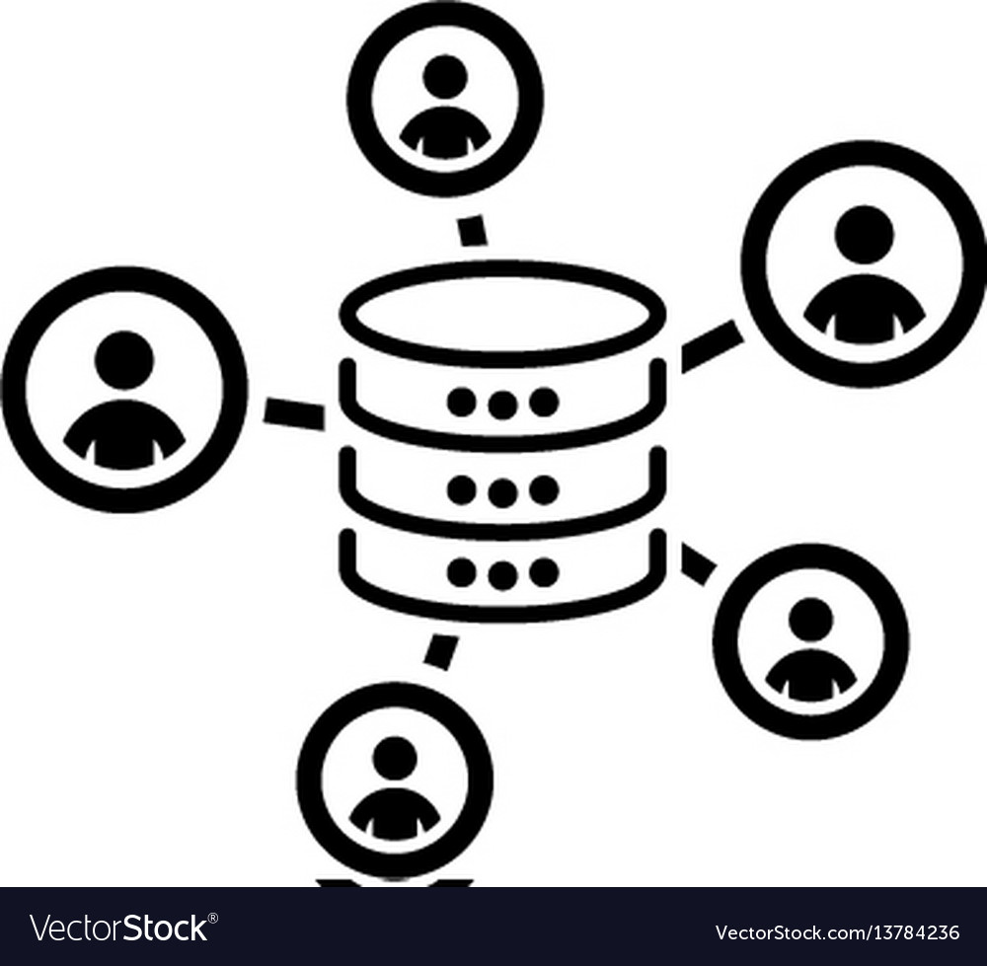



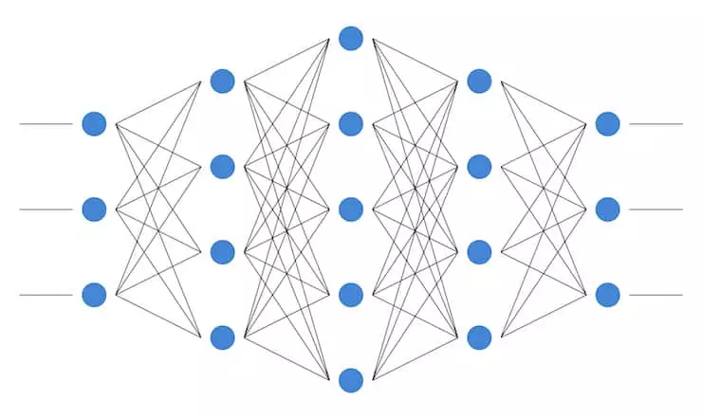
INTRODUCTION
Our solution
Data acquisition
Camera input
Output on screen
CNN
Trained model
6

Slide 7
02 RELATED WORK
7

Slide 8
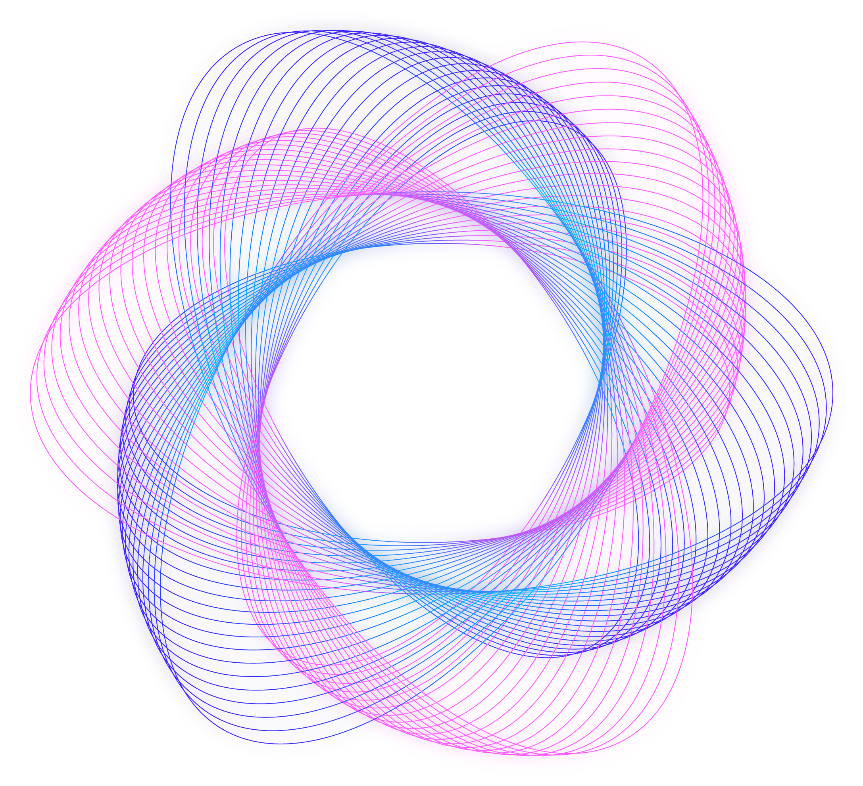





RELATED WORK
INDIAN SL
ITALIAN SL
AMERICAN SL
PORTUGUESE SL
BRITISH SL
8

Slide 9
RELATED WORK
 | Indian SL | Italian SL | Portuguese SL | British SL | American SL
Model | Haar cascade classifier | CNN | SVM | SVM | K-NN and SVM
Dataset size | 5250 | 11,008 | 4668 | 13,066 | 7900
Dataset type | Words | Letters | Letters | Letters | Letters
Accuracy | 92.68% | 99% | 99.6% | 99% | 98.7%
9

Slide 10
03 DATASET
10

Slide 11
The base dataset that we used is World Level American Sign Language (WLASL) from Kaggle
11

Slide 12



PROBLEMS WE FACED
It contains both static and dynamic signs
Some signs’ data are either missing or bad
Contains both videos and images
12

Slide 13
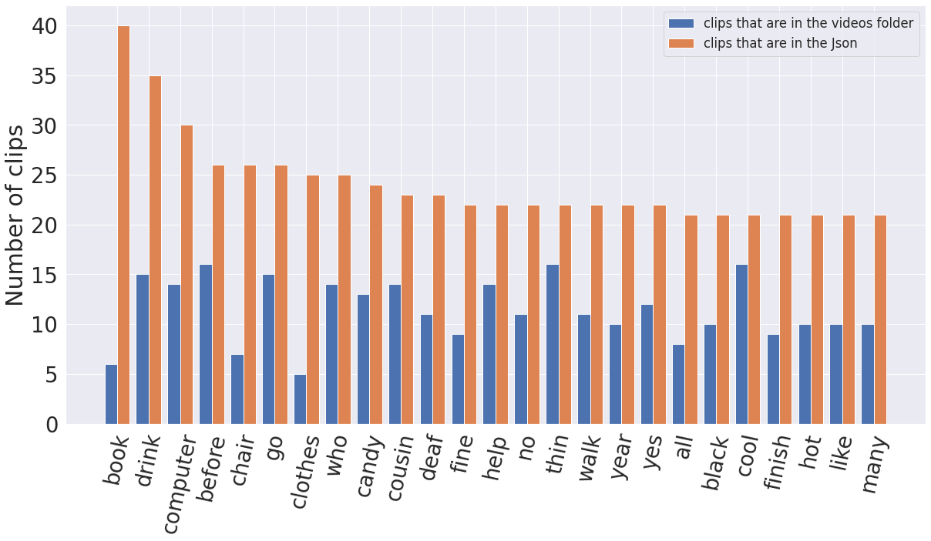
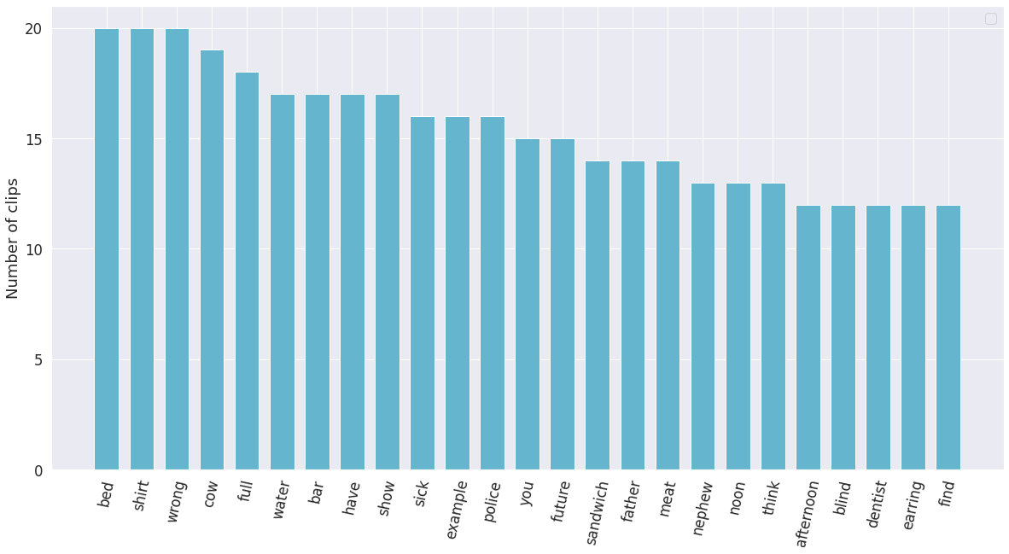
DATASET FIRST ITERATION
Top general 25 words
Top static 25 words
13

Slide 14
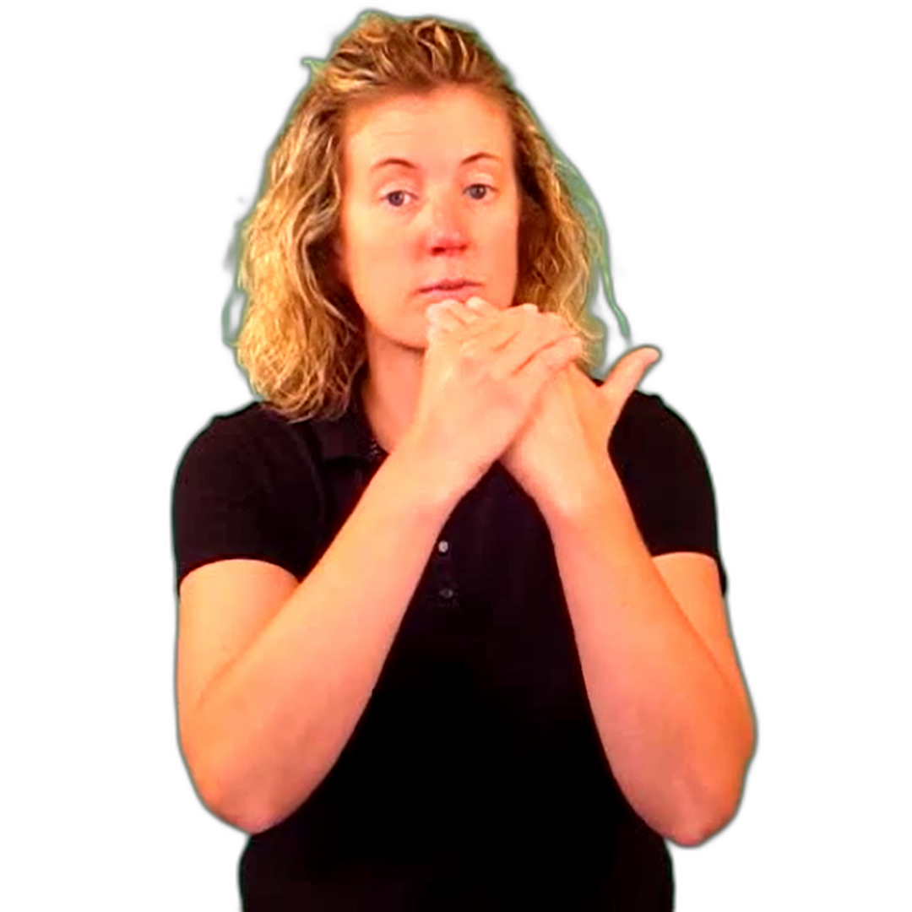
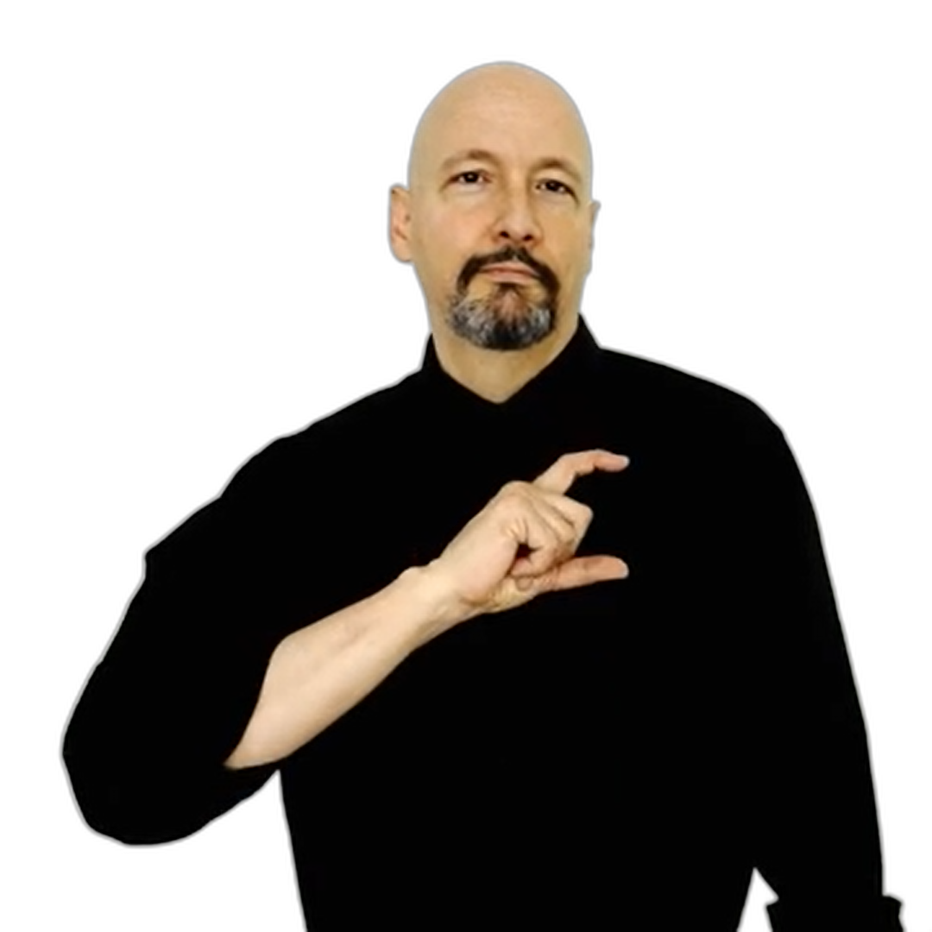
In the second iteration of the dataset was that we used YouTube and ASL Sign Bank to crop frames of the signed words in a 1080 x 1080 resolution, we removed the background for this iteration, but results was not good either
DATASET SECOND ITERATION
14

Slide 15
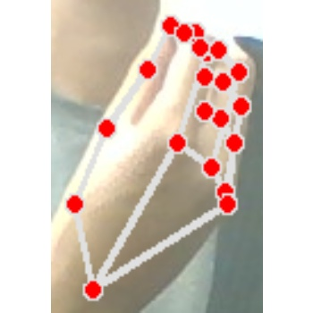
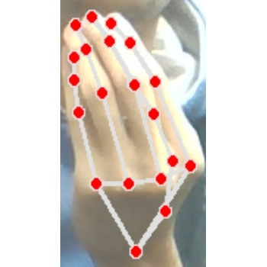
In the third and final iteration, we wanted to increase the dataset, so we took sample by ourselves and many people we ran by and focused only on the hand. The final dataset contained 15 words. All in a 350 x 350 resolution for uniform training.
DATASET THIRD ITERATION
15

Slide 16
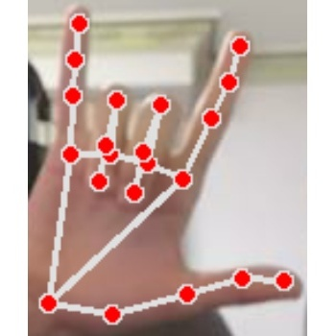
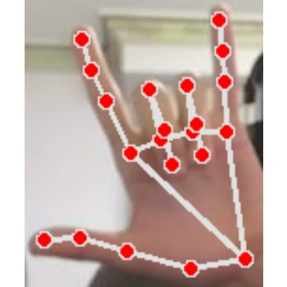
After finishing, to make the model more robust, and allow for both left and right-handed signs, we looped on all folders, and vertically flipped the images. After flipping, we ended up with 80 images for each word, which were then split into 60 training (30 normal and 30 flipped) and 20 validation (10 normal and 10 flipped) all of size 350 x 350.
Pre-processing and data augmentation
16

Slide 17















Yes
Police
Water
Wrong
Full
Shirt
I love you
Telephone
Have
Drink
Prefer
Hello
I
You
Food
17
Water

Slide 18
04 METHODOLOGY
18

Slide 19
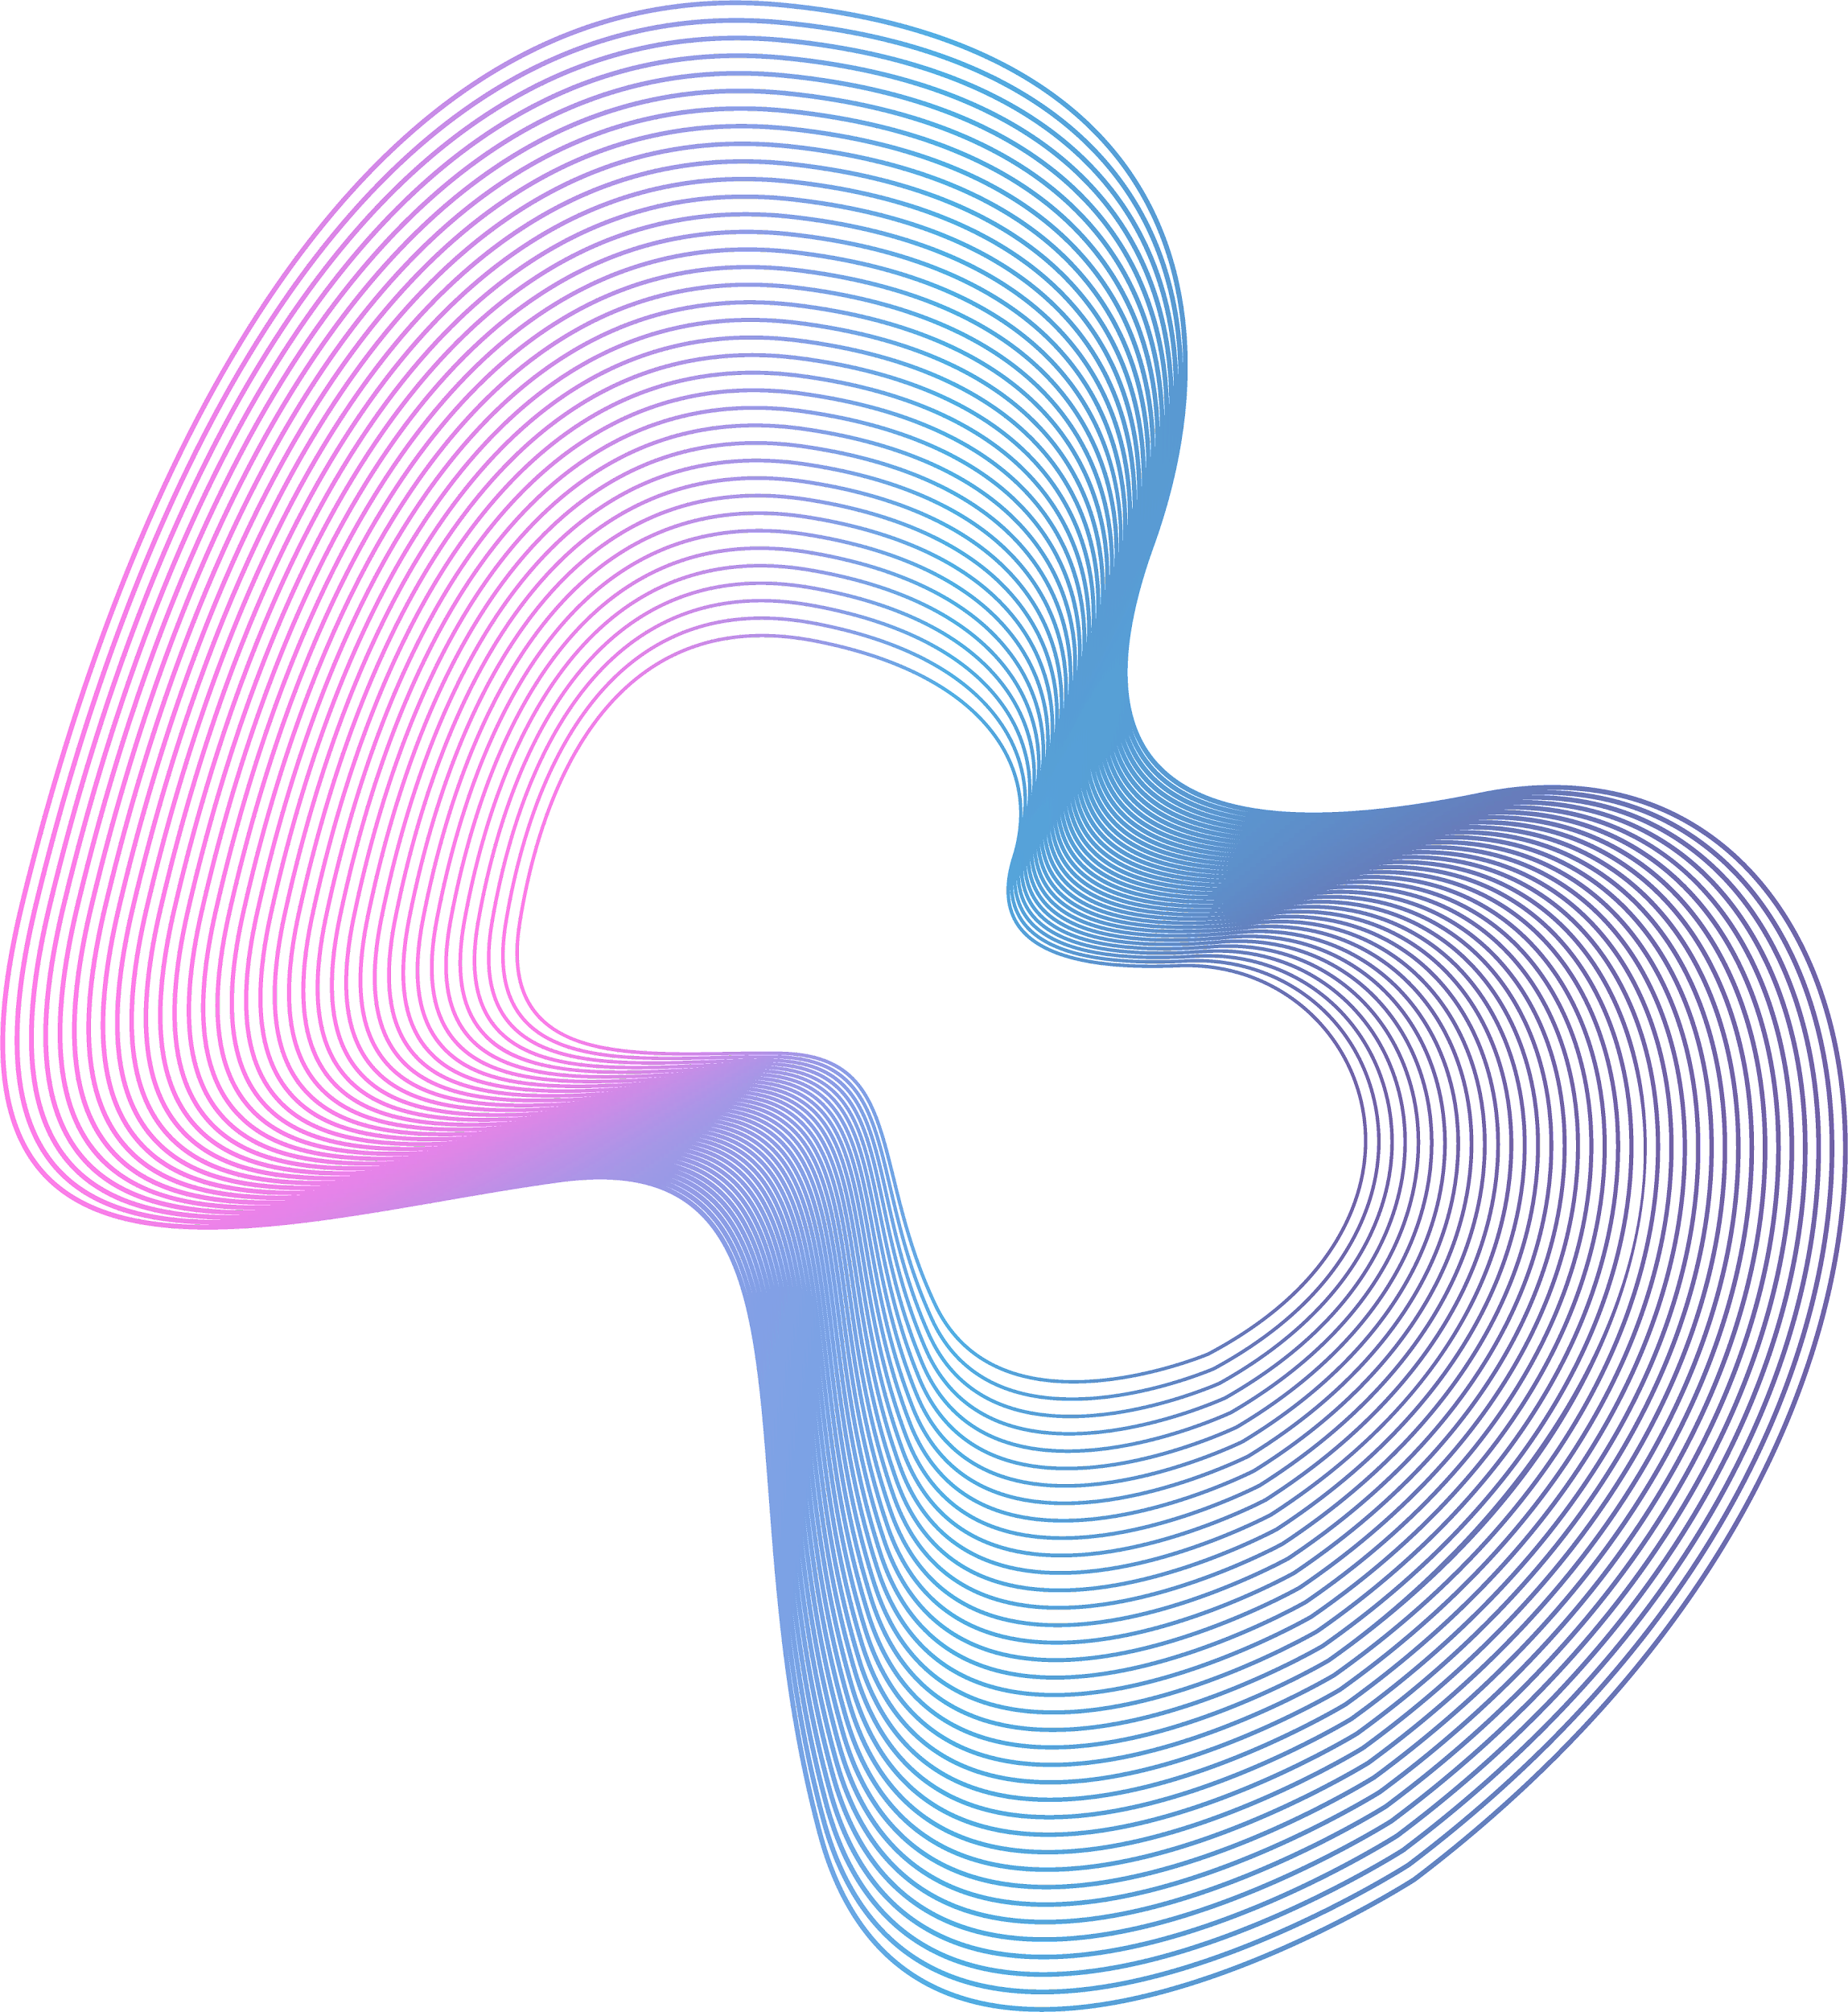


METHODOLOGY
Data Acquisition
Prediction Process
19

Slide 20
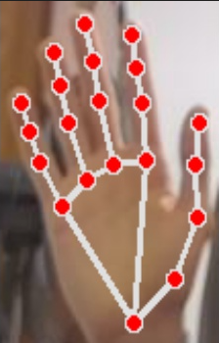




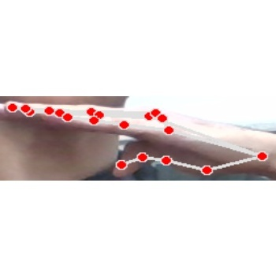
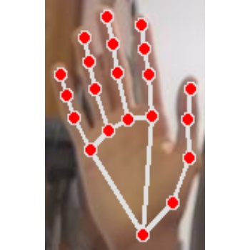




DATA ACQUISITION
01
02
03
04
Loop
Detect hand
Crop
Resize into box
08
07
06
05
Split
Flip
Save
Fill empty spaces
20

Slide 21



MODEL PREDICTION
01
02
03
04
Read frames
Detect hand
Crop
Resize into box
07
06
05
Display label
Predict
Fill empty spaces
21

Slide 22
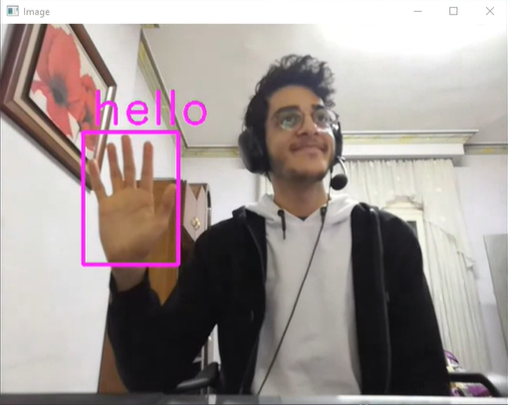
Model Prediction
22

Slide 23
05 RESULTS & COMPARISONS
23

Slide 24


RESULTS & COMPARISONS
Initial Version
Final Version
24

Slide 25
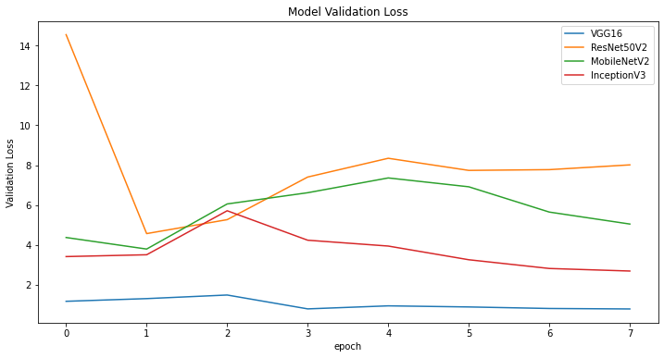
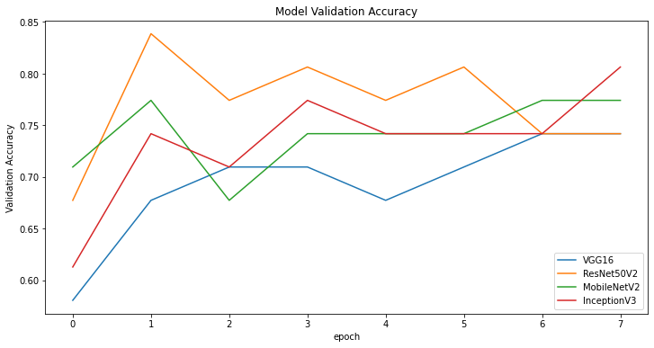
INITIAL VERSION
Training
25

Slide 26
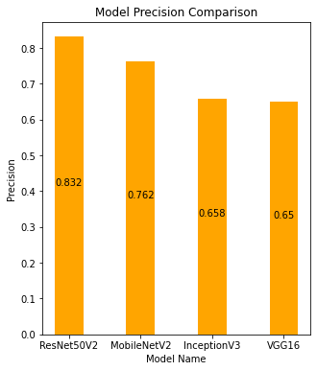
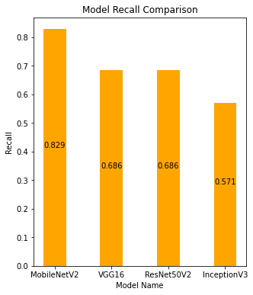
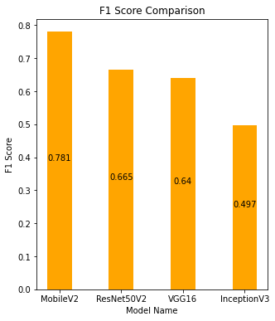
INITIAL VERSION
Testing
26

Slide 27
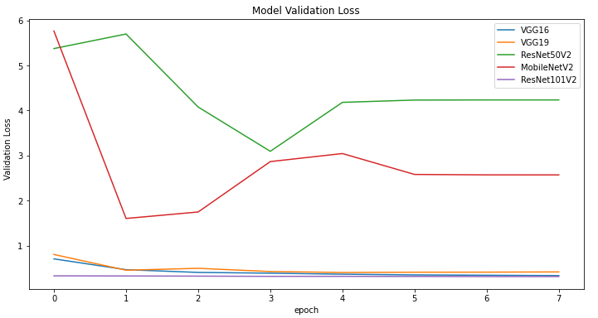
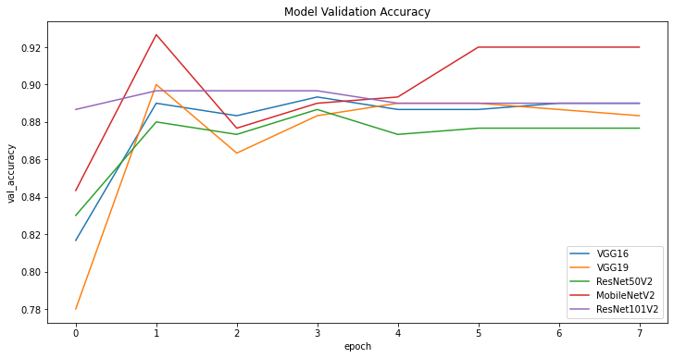
FINAL VERSION
Training
27

Slide 28
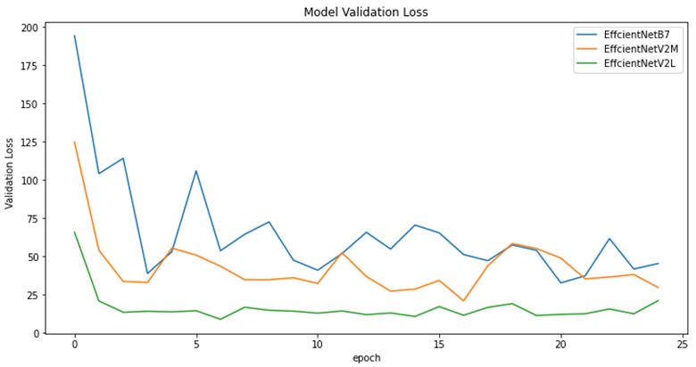
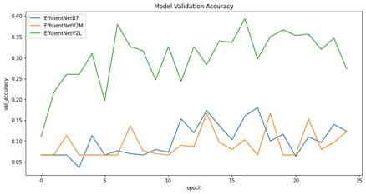
FINAL VERSION
Training
28

Slide 29
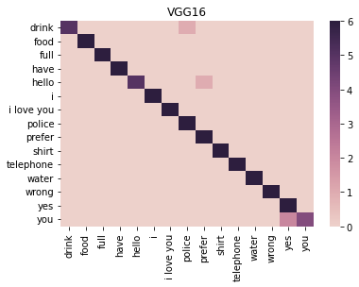
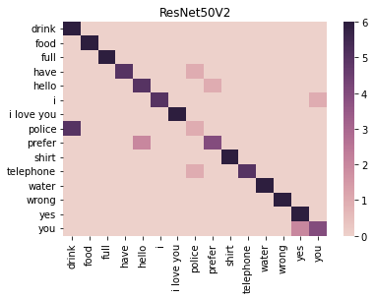
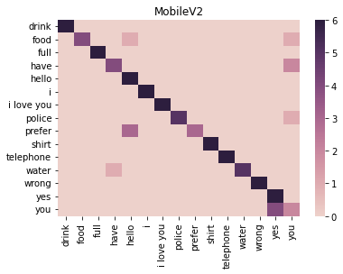
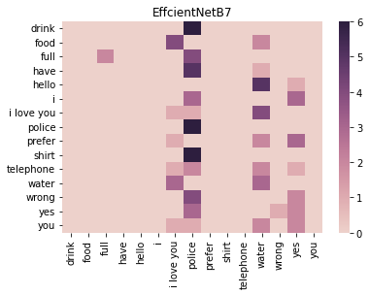
FINAL VERSION
Testing
29

Slide 30
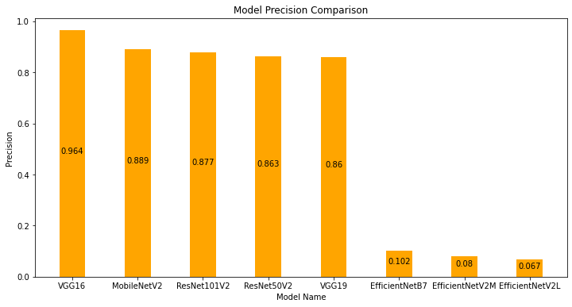
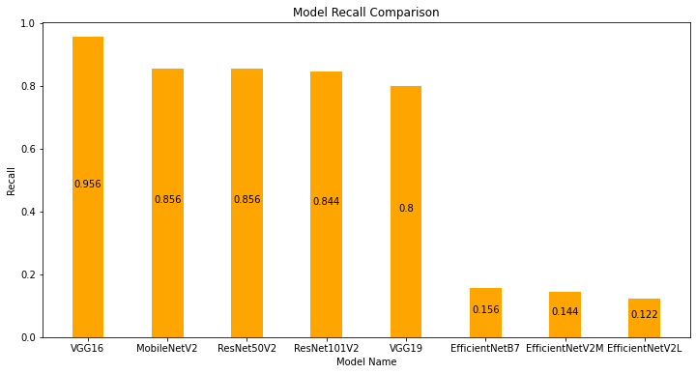
FINAL VERSION
Testing
30

Slide 31
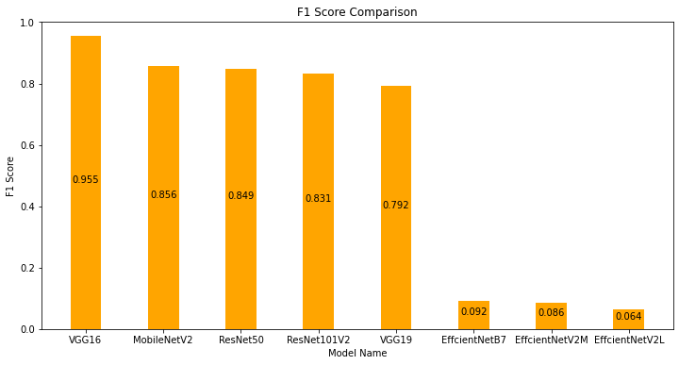
FINAL VERSION
Testing
31

Slide 32
COMPARISON
 | Indian SL | Italian SL | Portuguese SL | British SL | American SL | Our project
Model | Haar cascade classifier | CNN | SVM | SVM | K-NN and SVM | CNN
Dataset size | 5250 | 11,008 | 4668 | 13,066 | 7900 | 900
Dataset type | Words | Letters | Letters | Letters | Letters | Words
Accuracy | 92.68% | 99% | 99.6% | 99% | 98.7% | 96%
32

Slide 33
06 WEB APPLICATION
33

Slide 34



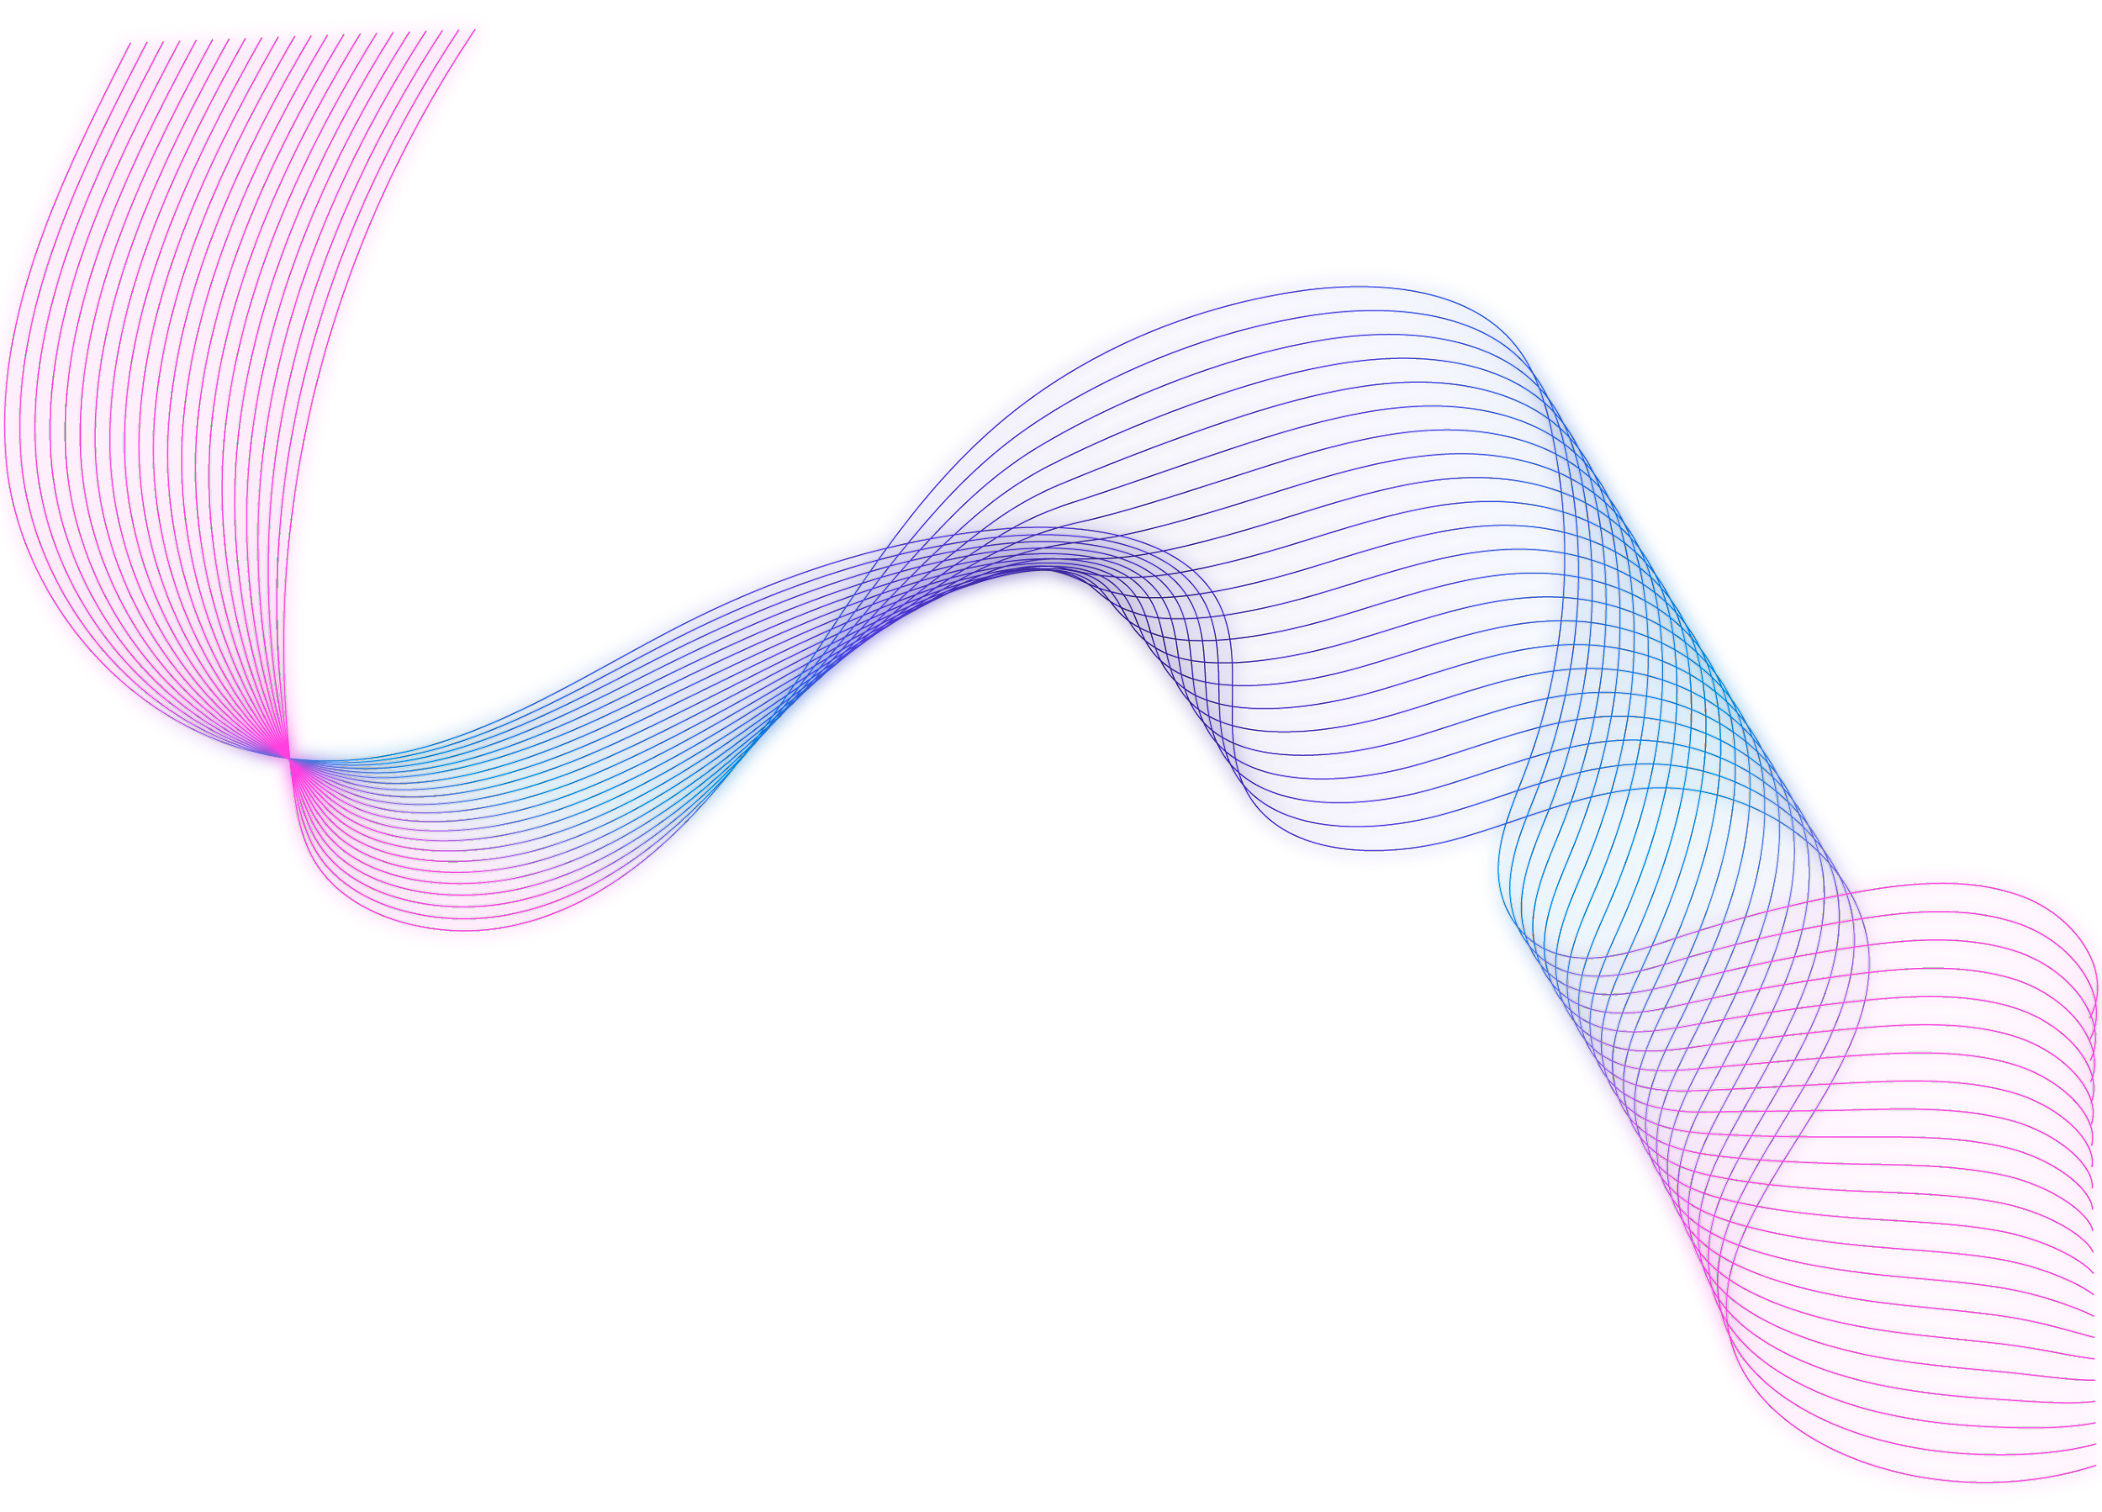
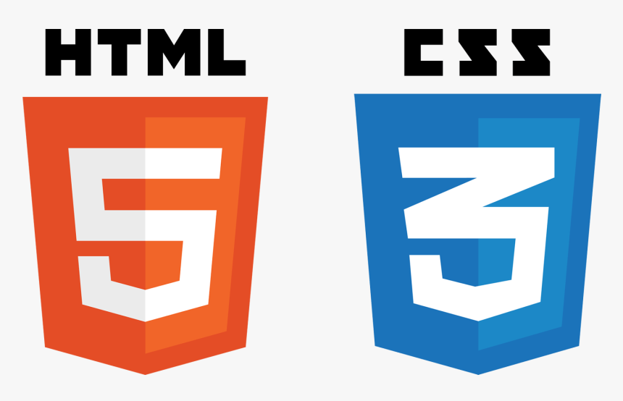
WEB APPLICATION
34

Slide 35
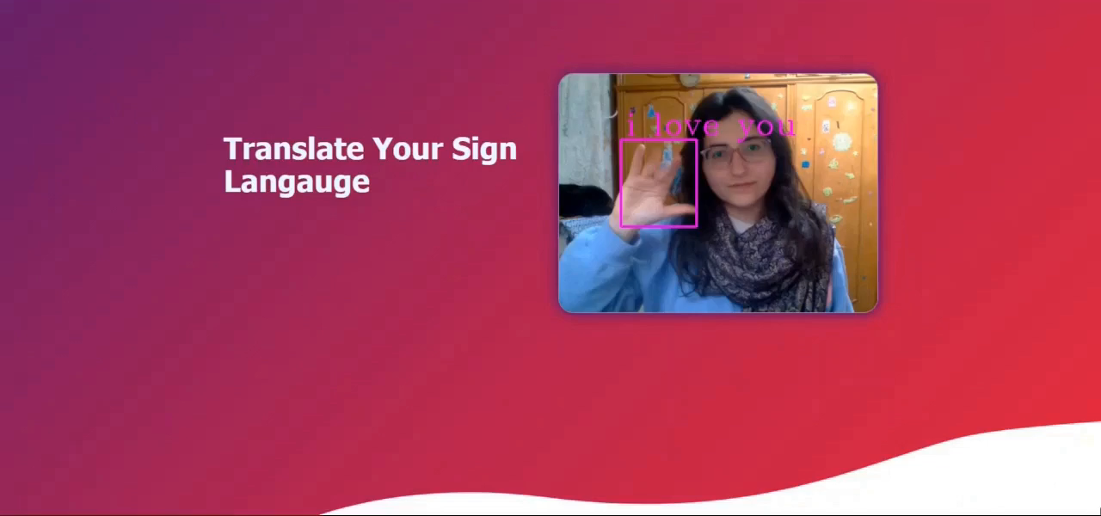
35

Slide 36
07 CONCLUSION & FUTURE WORK
36

Slide 37
In conclusion, the VGG-16 model was the best in accuracy among the other models that we have tested, where its accuracy scored an average of 96%
CONCLUSION
37

Slide 38

FUTURE WORK
Dynamic Hand Signs
38

Slide 39
THANK YOU
39

